Slide 1

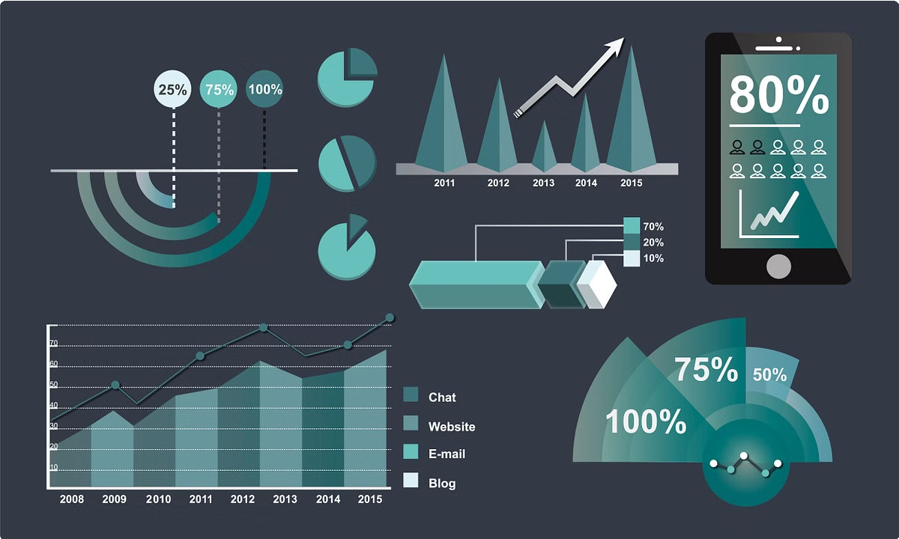
Sales Píediction using Python
Sales prediction, an essential tool for businesses to forecast future revenue and optimize operations. Python provides a robust ecosystem of libraries and tools for tackling this task.

Slide 2


Data Collection and Preprocessing
1 2 3
Data Acquisition
Gather data from various sources, including internal databases, APIs, and external datasets.
Data Cleaning
Handle missing values, remove duplicates, and transform data to ensure consistency and accuracy.
Data Transformation
Convert categorical features into numerical ones and apply scaling techniques for better model performance.

Slide 3
Feature Engineering
Feature Selection
Identify relevant features that contribute to sales prediction, eliminating irrelevant ones.
Feature Creation
Derive new features from existing ones to capture complex relationships and patterns.
Feature Scaling
Standardize features to ensure they are on a similar scale, preventing bias in model training.

Slide 4

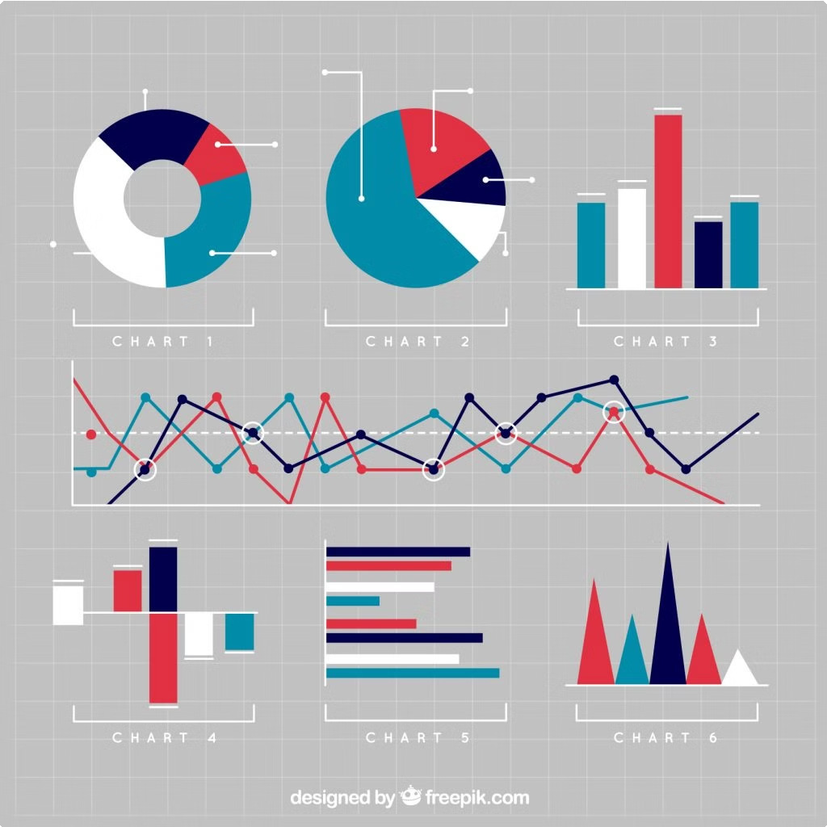
Exploratory Data Analysis
Data Summary
Calculate descriptive statistics to gain insights into data distribution and relationships.
Create informative visualizations such as histograms, scatter plots, and correlation matrices.
1
2
Data Visualization
3
Pattern Identification
Analyze trends, seasonality, and other patterns that can influence sales.

Slide 5

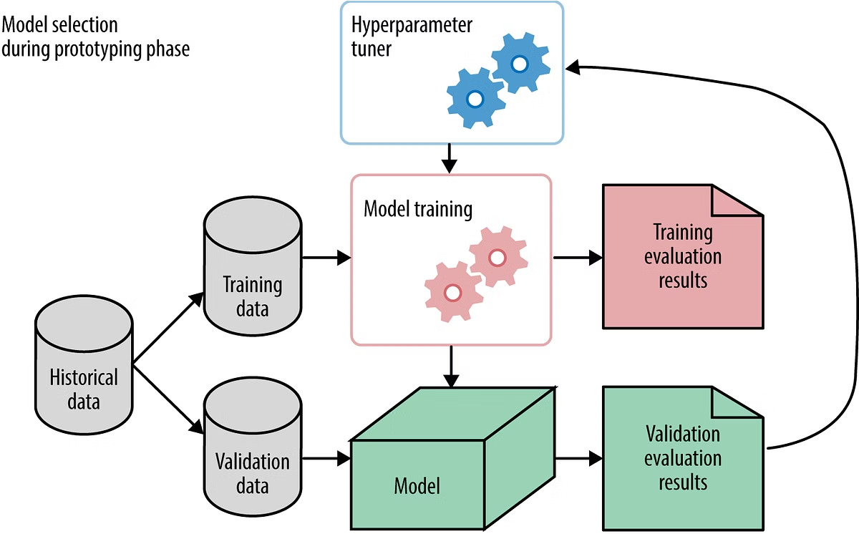
Model Selection and Training
Linear Regression
A simple and interpretable model suitable for predicting continuous sales values.
Time Series Models
Models like ARIMA and Prophet are well-suited for forecasting time-dependent sales patterns.
Machine Learning Models
Consider models like Decision Trees, Random Forests, or Gradient Boosting for complex relationships.

Slide 6


Hyperparameter Tuning
Grid Search
Try different combinations of hyperparameters within a specified range.
1
Random Search
Randomly sample hyperparameter values, offering greater efficiency for large search spaces.
2
Bayesian Optimization
Utilize a probabilistic model to guide the search for optimal hyperparameters.
3

Slide 7
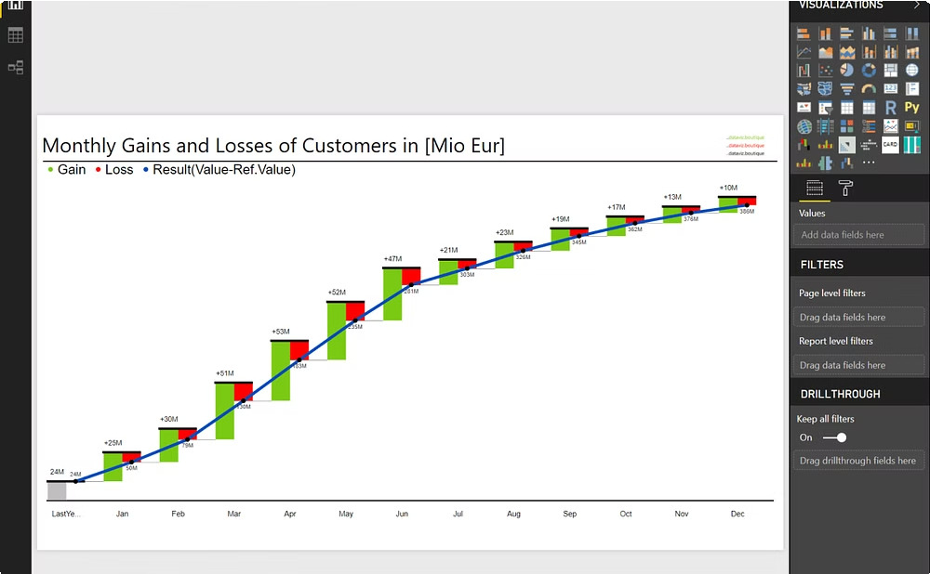
Sales Forecasting and Prediction
Time Series Forecasts
Predict future sales based on historical data and patterns.
Scenario Analysis
Explore different scenarios and their impact on sales predictions.

Slide 8
Deployment and Integration
Cloud Deployment
Deploy the sales prediction model on a cloud platform for scalability and accessibility.
API Integration
Create an API to enable seamless integration with other applications and systems.
Interactive Dashboards
Develop interactive dashboards for visualization and monitoring of sales predictions.

Slide 9


Conclusion and Future Considerations
Python empowers businesses to make data-driven decisions and achieve greater sales success. Further explore advanced techniques like deep learning and ensemble methods for even more accurate sales prediction.

Slide 10


